Slide 1
Hydroelectricity is the major renewable source of electricity production which helps in reducing CO2 emission
Output of panel data regression: Fixed Effects Model
The below numbers indicate by how much each factor affects CO2 emission (kt) when electricity production through the sources mentioned below increases by 1 %
Source of electricity production | Effect on CO2 emission
Hydroelectricity | -582
Renewable energy source, excluding hydroelectricity | -202
Nuclear energy | 790
Oil source | -519
“ Electricity and heat generation is the economic sector that produces the largest amount of man-made carbon dioxide emissions. “

Slide 2
Univariate analysis:

Slide 3
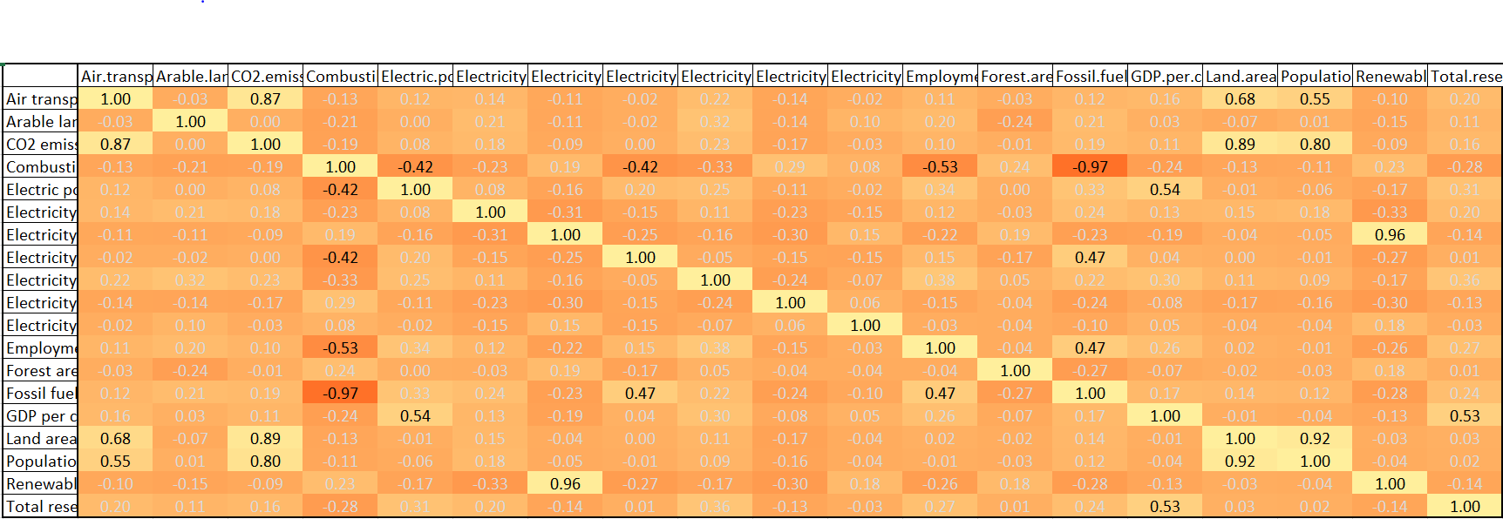
Bivariate Analysis:

Slide 4
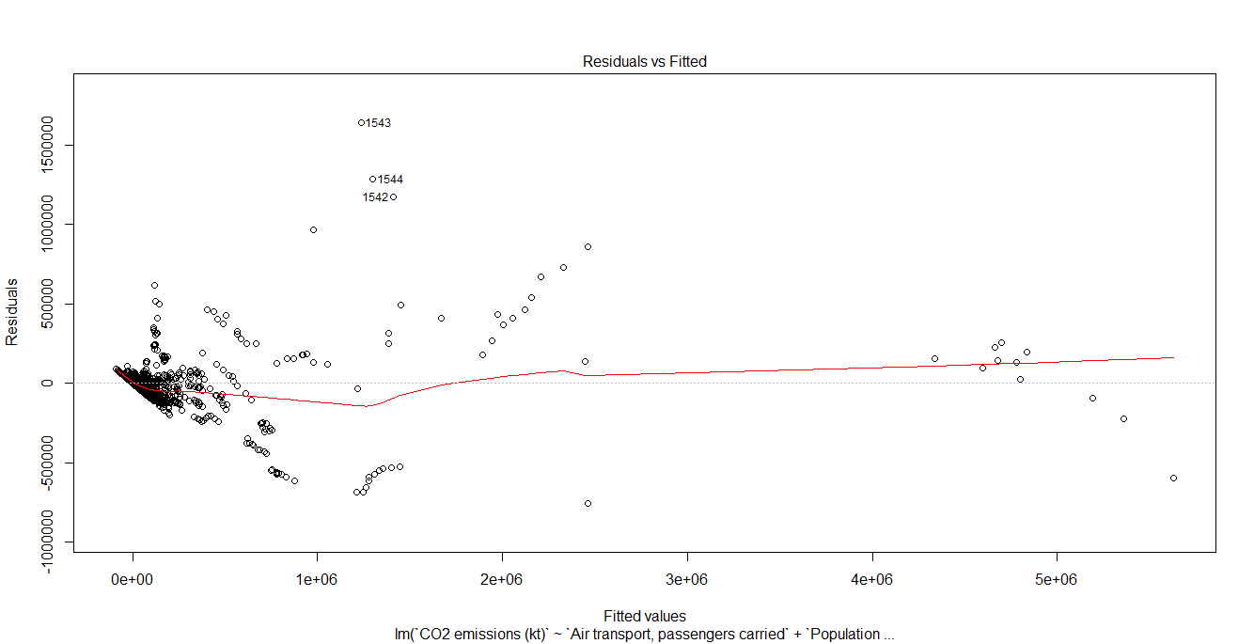
Normality:
Dependent variable CO2 emission (kt) was considerably skewed and hence used logarithmic transformations.
Below are the graphs obtained after normalization:
Normal qq plot
Homoskedasticity:
Since there is no pattern, we can conclude that the variance of error terms are similar.

